Slide 1
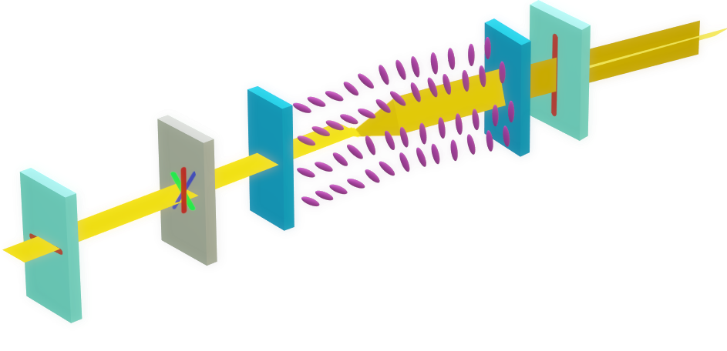

TRANSMITTER
Polarizer films (with orthogonal axes)
Unpolarized light
RECEIVER
Liquid crystal layer
Glass substrate
Dispersor
Phone

Slide 2
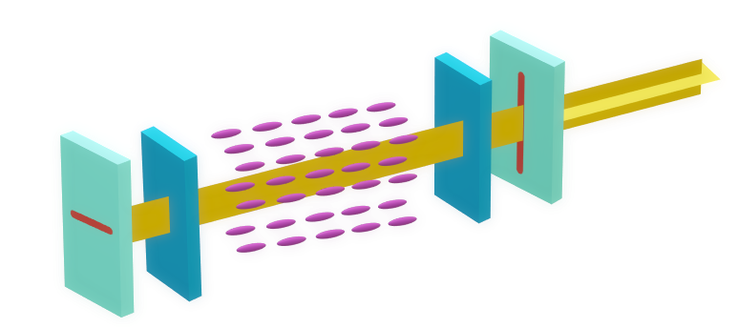
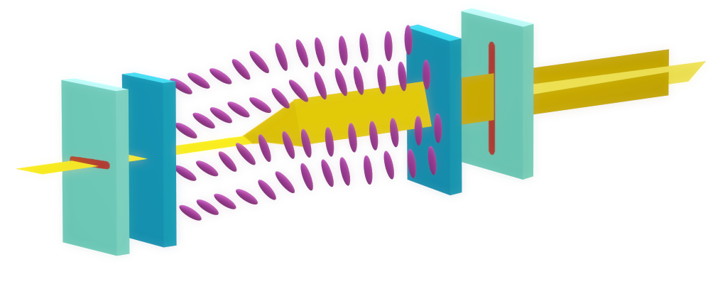
Voltage applied
Unpolarized light
Liquid crystal layer
Polarizer films (vertical axis)
Glass substrate
Polarizer films (horizontal axis)
No voltage applied
Unpolarized light
Liquid crystal layer

Slide 3

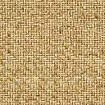
Mirror
Retroreflector
Diffuser

